Slide 1

Project Title
Crafting Compelling
Web Presences

Slide 2
Project Overview
In this immersive project, you'll dive deep into the intricacies of website design, exploring the fundamental elements that make websites tick. From understanding the inner workings of websites to deciphering the essential design principles, you'll uncover the key ingredients necessary to create a standout online presence.
But it won't stop there. Through a series of hands-on activities and real-time exercises, you'll put theory into practice as you roll up your sleeves and build websites and landing pages from scratch. Armed with a toolkit of digital marketing strategies and best practices in website design, you'll breathe life into your creations, turning ideas into interactive digital experiences.
As a Digital Marketing Intern, exploring the fundamentals of digital marketing as this project is designed to help you understand website dynamics and essential design principles, enabling you to create compelling web presences. Through practical tasks, you'll learn to build websites and landing pages from scratch, applying digital marketing strategies for effective online engagement.

Slide 3
TASK 1 Understand their products or services and create short descriptions for a minimum of 3 and a
maximum of 5 products or services.
Certainly, Here I’m considering myself as a digital marketing intern at Infosys company
Infosys Digital Innovation Services: Infosys Digital Innovation Services empower businesses to embrace digital transformation and drive innovation. Leveraging cutting-edge technologies such as AI, IoT, blockchain, and cloud computing, Infosys helps organizations reimagine their operations, enhance customer experiences, and accelerate growth in the digital age. From strategy and consulting to implementation and support, Infosys provides end-to-end solutions tailored to meet the evolving needs of businesses across industries.
Infosys Cloud Services: Infosys Cloud Services offer comprehensive cloud solutions to help enterprises modernize their IT infrastructure, optimize costs, and achieve agility and scalability. With expertise in leading cloud platforms such as AWS, Microsoft Azure, and Google Cloud Platform, Infosys enables businesses to migrate, deploy, and manage workloads in the cloud securely and efficiently. From cloud strategy and migration to application development and management, Infosys empowers organizations to harness the full potential of cloud computing for innovation and growth

Slide 4
3.Infosys AI and Analytics Solutions: Infosys AI and Analytics Solutions harness the power of data and artificial intelligence to drive insights, enhance decision-making, and unlock new opportunities for businesses. With advanced analytics capabilities and machine learning algorithms, Infosys helps organizations extract actionable insights from data, predict trends, and optimize operations across various domains such as finance, healthcare, retail, and manufacturing. From data integration and visualization to predictive modeling and cognitive automation, Infosys delivers customized solutions to drive business value and competitive advantage.
4.Infosys Blockchain Solutions: Infosys Blockchain Solutions enable businesses to harness the transformative potential of blockchain technology to drive transparency, security, and efficiency across industries. With expertise in distributed ledger technology, smart contracts, and decentralized applications, Infosys helps organizations streamline processes, reduce friction in transactions, and foster trust among stakeholders. From supply chain management and financial services to healthcare and logistics, Infosys offers tailored blockchain solutions to address diverse business challenges and unlock new opportunities for innovation and collaboration

Slide 5
TASK 2 Determine the platform on which the website is developed (Use online tools to identify).
According to the analysis conducted using the WAPPALYZER online tool, it has been identified that the Infosys website is built using ADOBE EXPERIENCE MANAGER (AEM). This platform, known for its robust content management capabilities, allows organizations like Infosys to create, manage, and optimize digital experiences across multiple channels and devices. With Adobe Experience Manager, Infosys can efficiently deliver personalized and engaging content to its audience while maintaining consistency and scalability across its digital ecosystem.
It's noted that Wappalyzer provided additional insights regarding the tools used in the Infosys website. Through the shared images, it's evident that the website employs a variety of technologies and frameworks to enhance its functionality and user experience. These tools may include JavaScript frameworks like React.js or Angular.js, CSS preprocessors like Sass or LESS, and server-side technologies such as Apache and Node.js. Additionally, content delivery networks (CDNs) and analytics platforms may also be in use to optimize website performance and track user behavior. By leveraging a diverse set of tools and technologies, Infosys demonstrates its commitment to delivering a seamless and feature-rich online experience for its visitors.

Slide 6
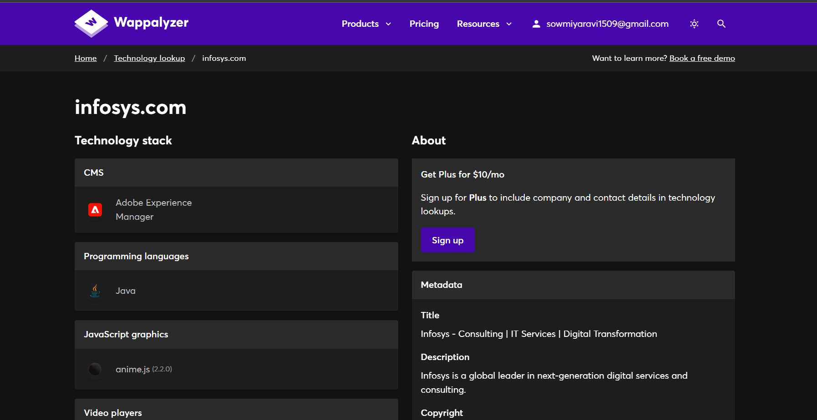

Slide 7
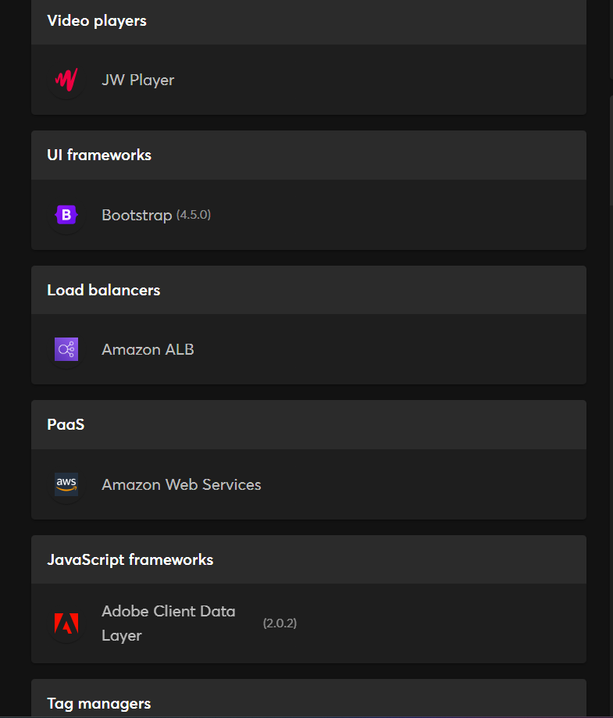
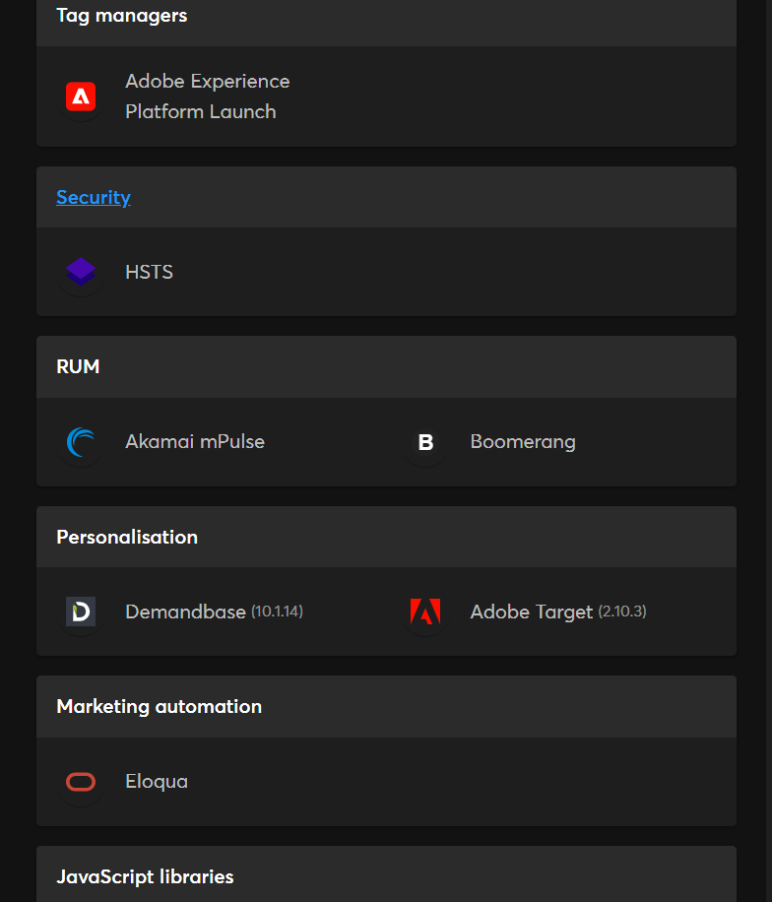
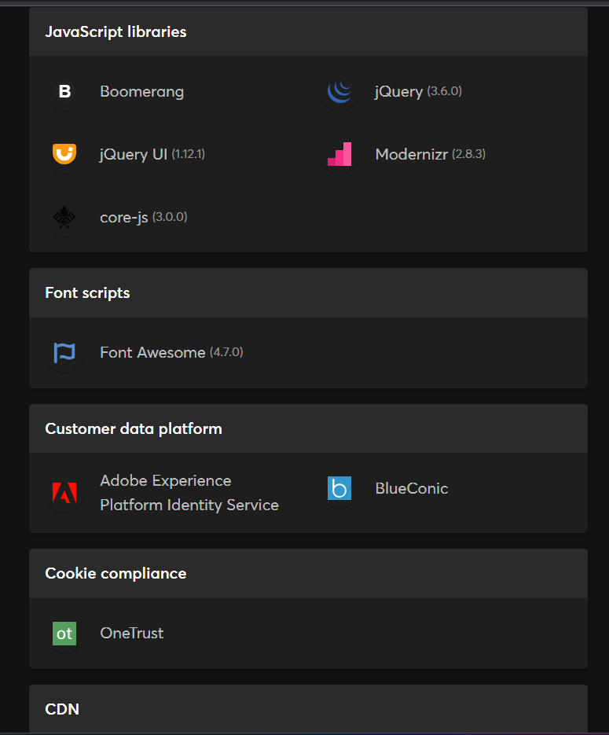

Slide 8
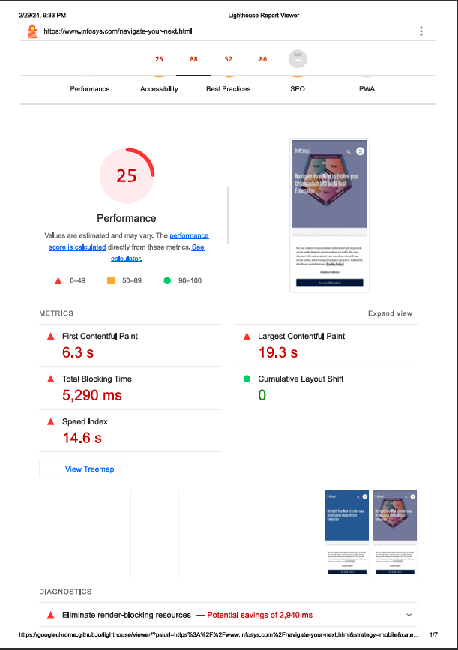
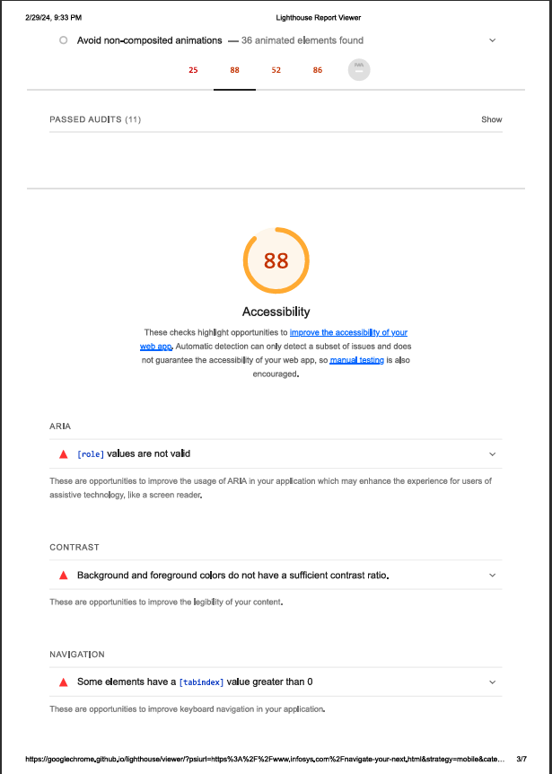
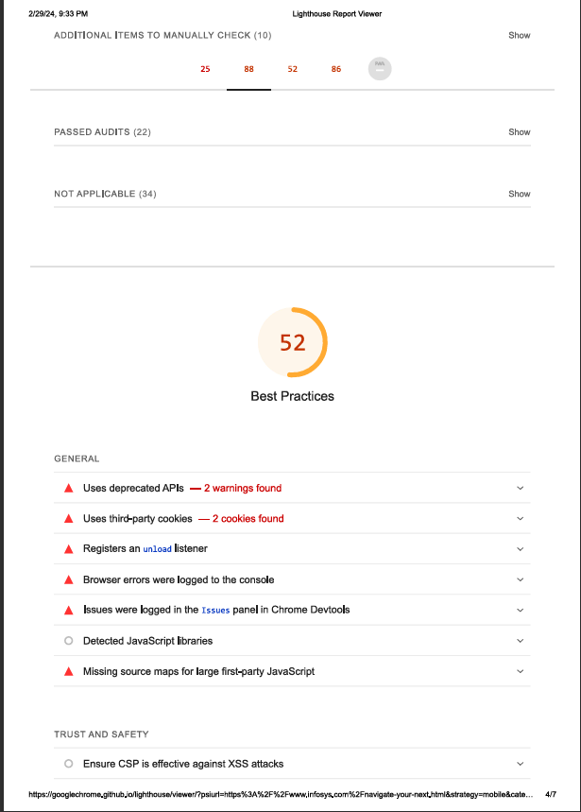
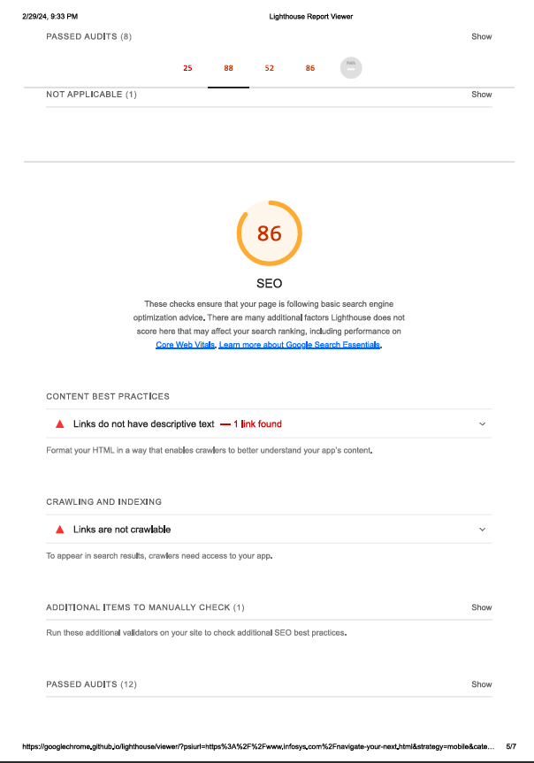
TASK 3 Test the website's responsive design and mobile optimization (using lighthouse testing tool)
PAGE:NAVIGATE YOUR NEXT REPORT

Slide 9
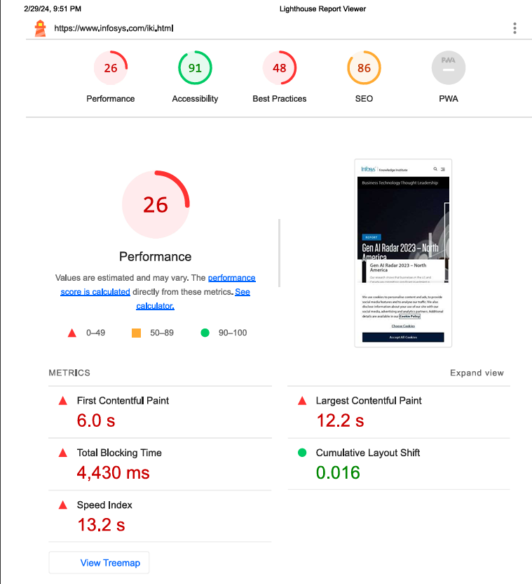
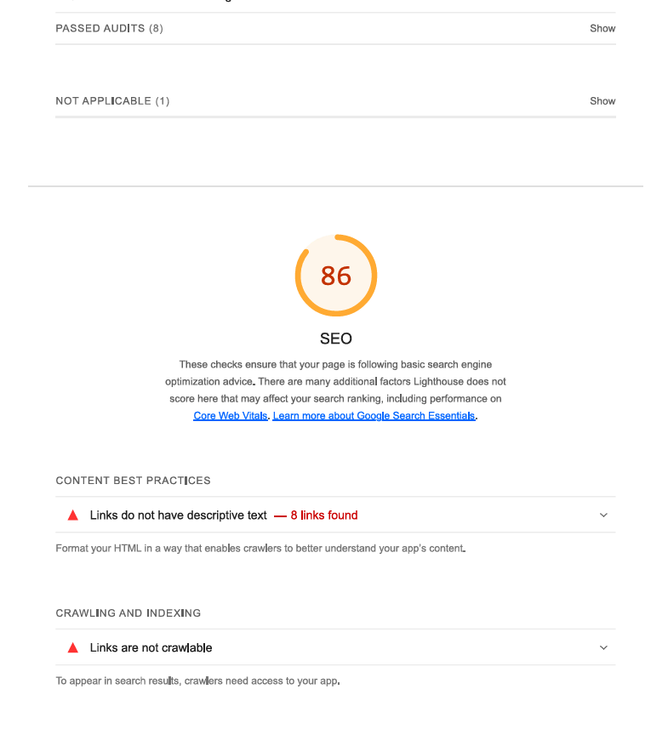
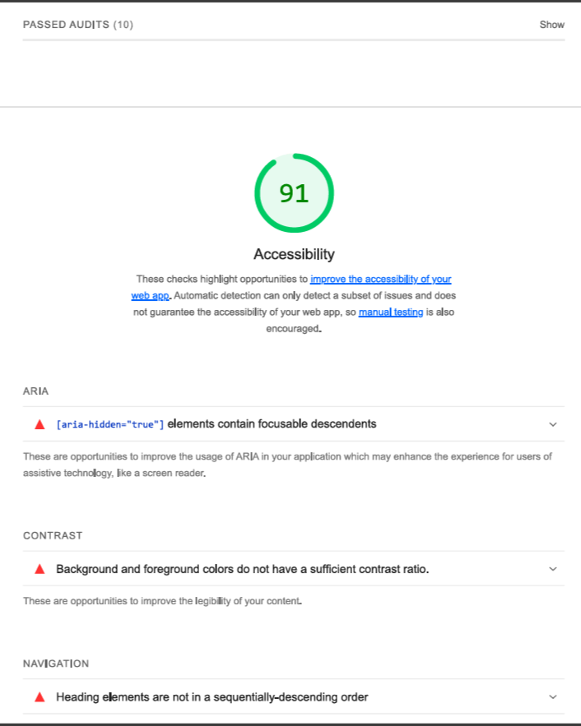
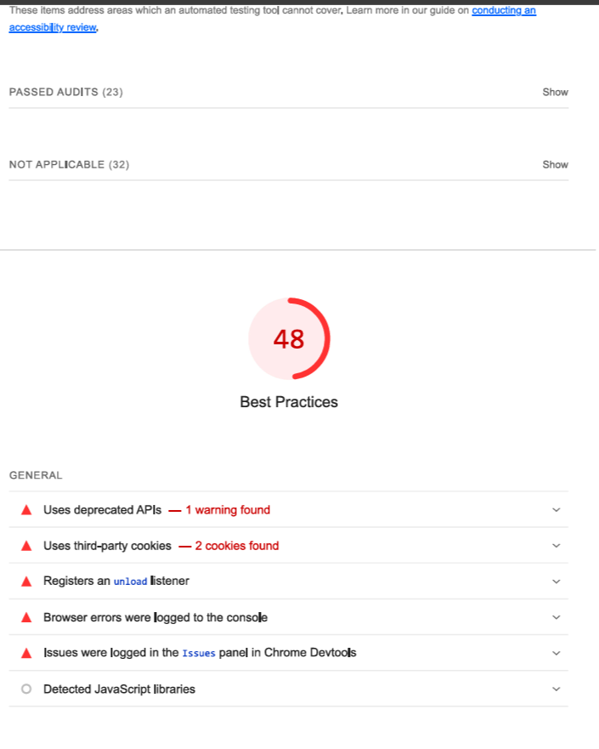
PAGE: INFOSYS KNOWLEDGE INSTITUTE REPORT

Slide 10
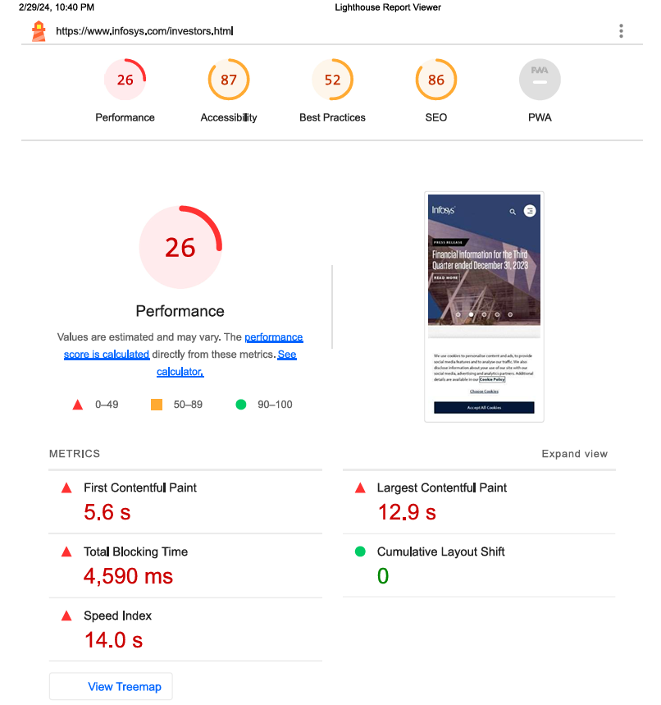
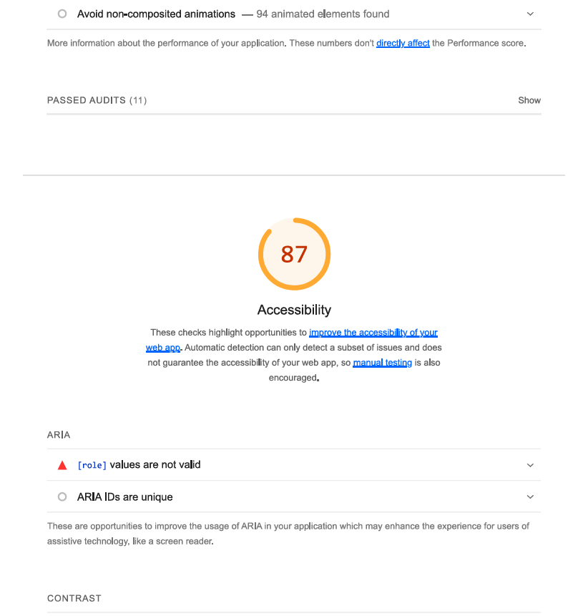
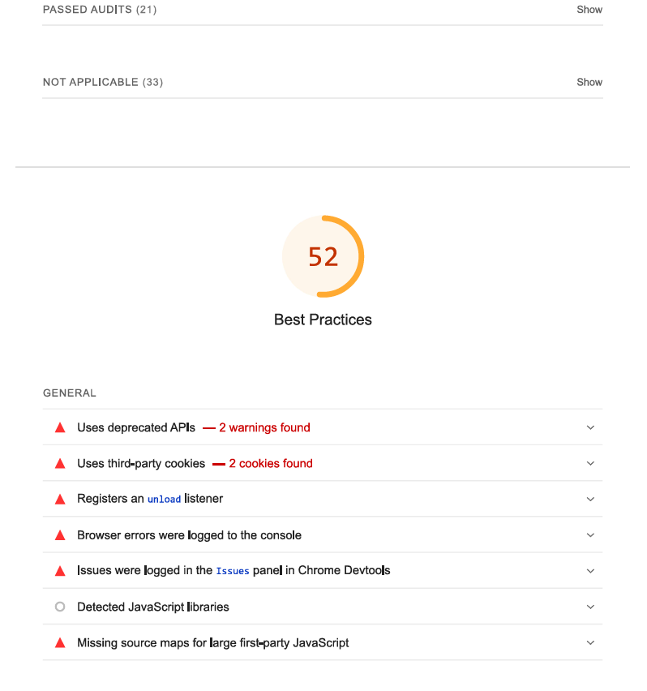
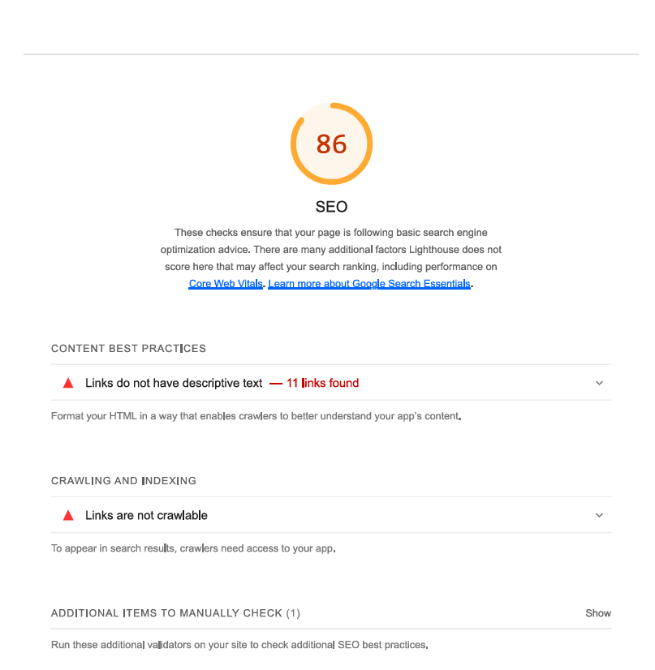
PAGE: INVESTORS REPORT

Slide 11
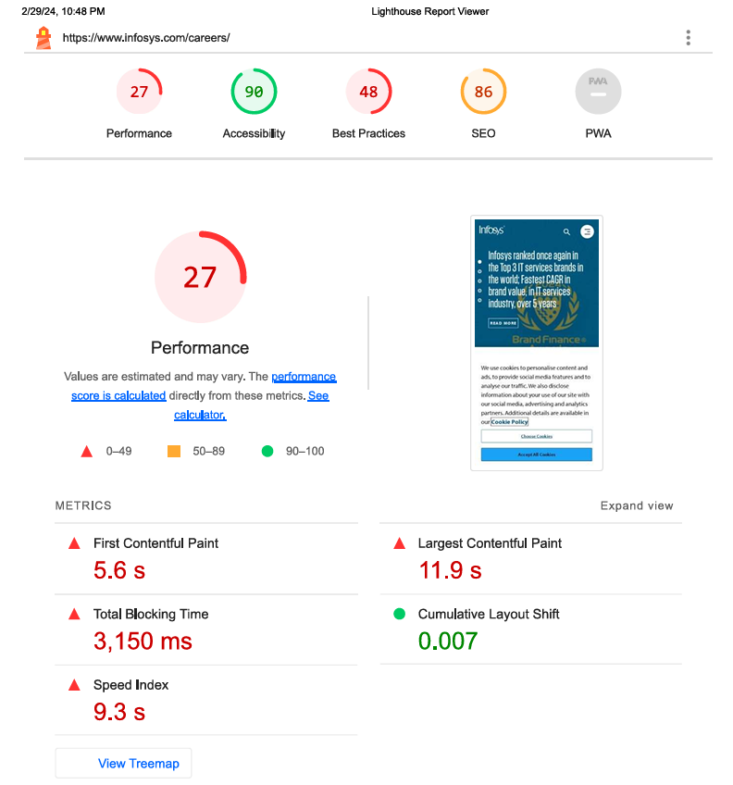
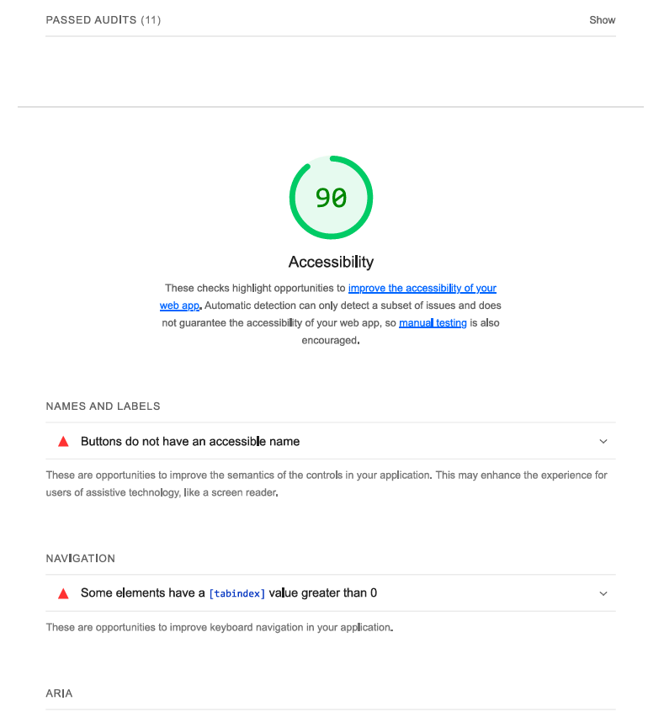
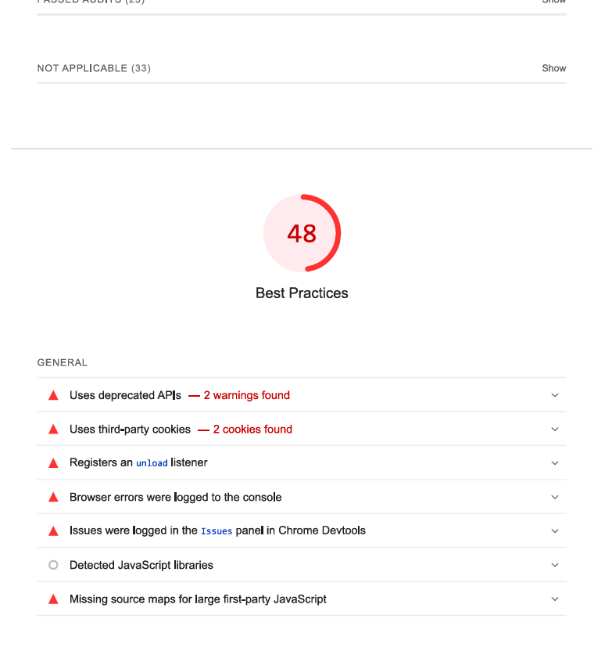
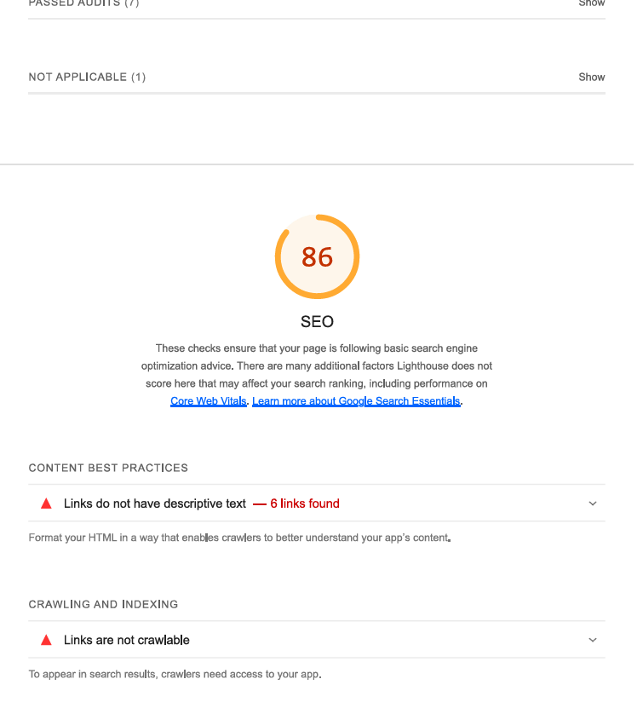
PAGE: CAREER REPORT

Slide 12
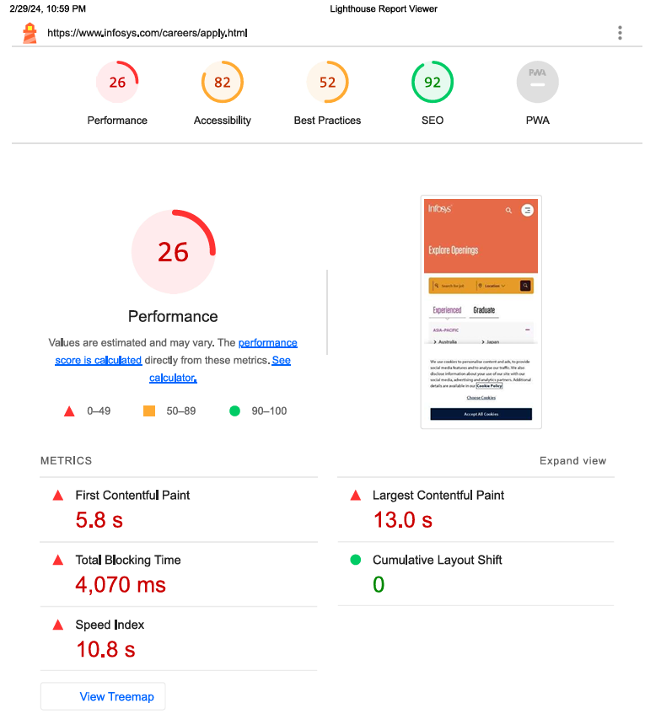
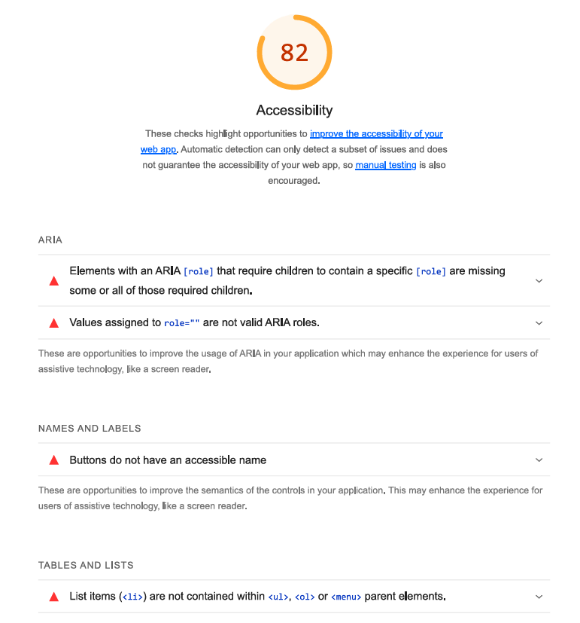
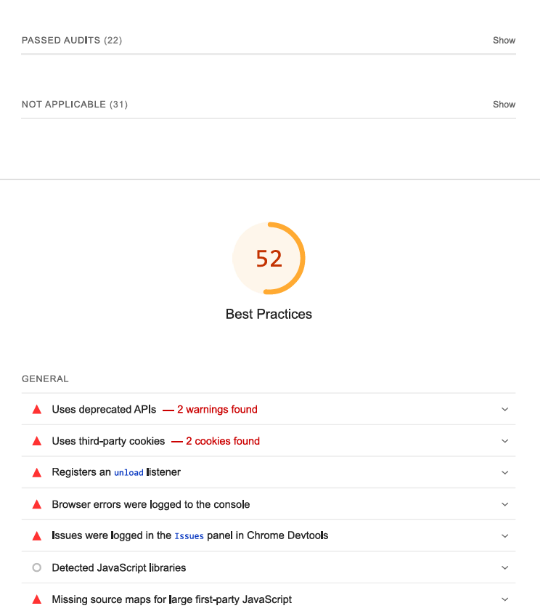
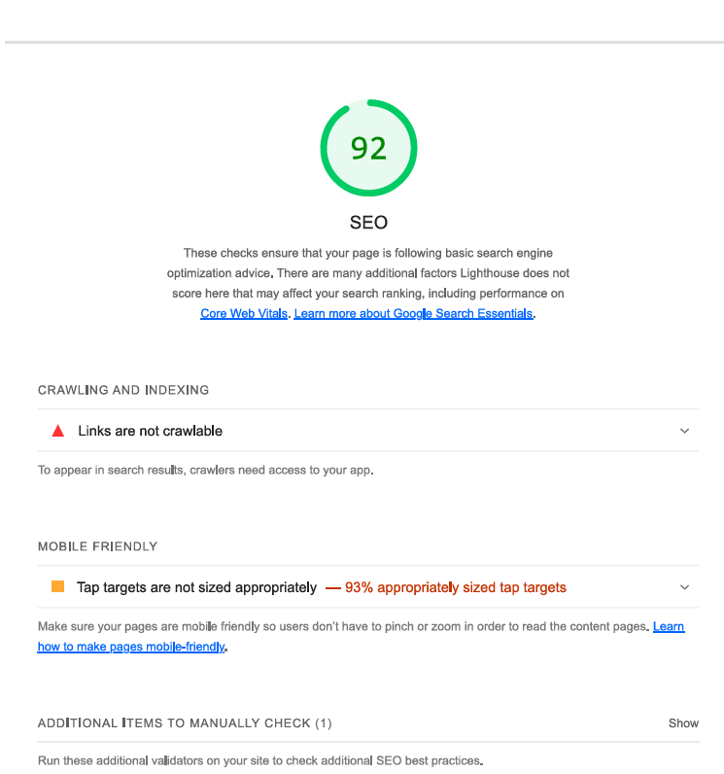
PAGE: APPLY NOW REPORT

Slide 13
TASK 4 Identify common website design mistakes to avoid, such as cluttered layouts and slow loading times.
Poor Navigation:
Ensure intuitive navigation with clear menus and navigation bars.
Use descriptive labels and categories to help users find what they're looking for quickly.
Avoid excessive nesting of menus or dropdowns, which can confuse users.
Slow Loading Times:
Optimize images and multimedia files to reduce loading times.
Minimize HTTP requests by combining CSS and JavaScript files.
Use caching and content delivery networks (CDNs) to speed up website performance.
Unresponsive Design:
Ensure your website is responsive and accessible across various devices and screen sizes.
Test your website on different browsers and devices to ensure compatibility.
Use responsive design frameworks like Bootstrap or Foundation to build mobile-friendly layouts.

Slide 14
4.Inconsistent Branding:
Maintain consistency in branding elements such as colors, fonts, and logos across all pages.
Use a cohesive design theme that reflects your brand identity and values.
Avoid mixing conflicting design styles or themes that can confuse visitors.
5.Poor Readability:
Use legible fonts and font sizes for body text and headings.
Ensure sufficient color contrast between text and background for readability.
Break up long paragraphs into shorter, digestible chunks for easier reading.
6.Lack of Call-to-Action (CTA):
Include clear and compelling CTAs throughout your website to guide users towards desired actions.
Use persuasive language and placement to encourage user engagement, such as "Sign Up Now" or "Learn More".

Slide 15
TASK 5 Provide a list of best practices for creating visually appealing and user-friendly website designs.
Simplify Navigation:
Use clear and intuitive navigation menus to help users easily find the information they need.
Limit the number of menu items and organize them logically to reduce cognitive load.
Prioritize Content Hierarchy:
Use visual hierarchy to emphasize important content and guide users' attention.
Use larger fonts, bolder colors, and strategic placement to highlight key messages and calls-to-action.
Optimize Readability:
Choose legible fonts and appropriate font sizes for both desktop and mobile devices.
Ensure sufficient contrast between text and background colors to enhance readability, especially for users with visual impairments.
Use Consistent Branding:
Maintain consistency in branding elements such as colors, fonts, and logos across all pages.
Use a cohesive design theme that reflects your brand identity and values.

Slide 16
5.Utilize White Space:
Use white space effectively to improve visual clarity and reduce clutter.
Allow adequate spacing between elements to enhance readability and user experience.
6.Optimize Images and Multimedia:
Use high-quality images and multimedia content to enhance visual appeal.
Optimize file sizes to minimize loading times and improve website performance.
7.Ensure Mobile Responsiveness:
Design websites with a mobile-first approach to ensure compatibility across various devices and screen sizes.
Use responsive design techniques to adapt layout and content based on screen resolution.
8.Incorporate Visual Consistency:
Maintain visual consistency in layout, color scheme, and typography throughout the website.
Use grids and alignment to create a harmonious and balanced design

Slide 17
THANK YOU

